Slide 1
Coin detection using Catapult C on an FPGA
Mikkel Jordhan, Marco lavalle, Thomas Nugent

Slide 2
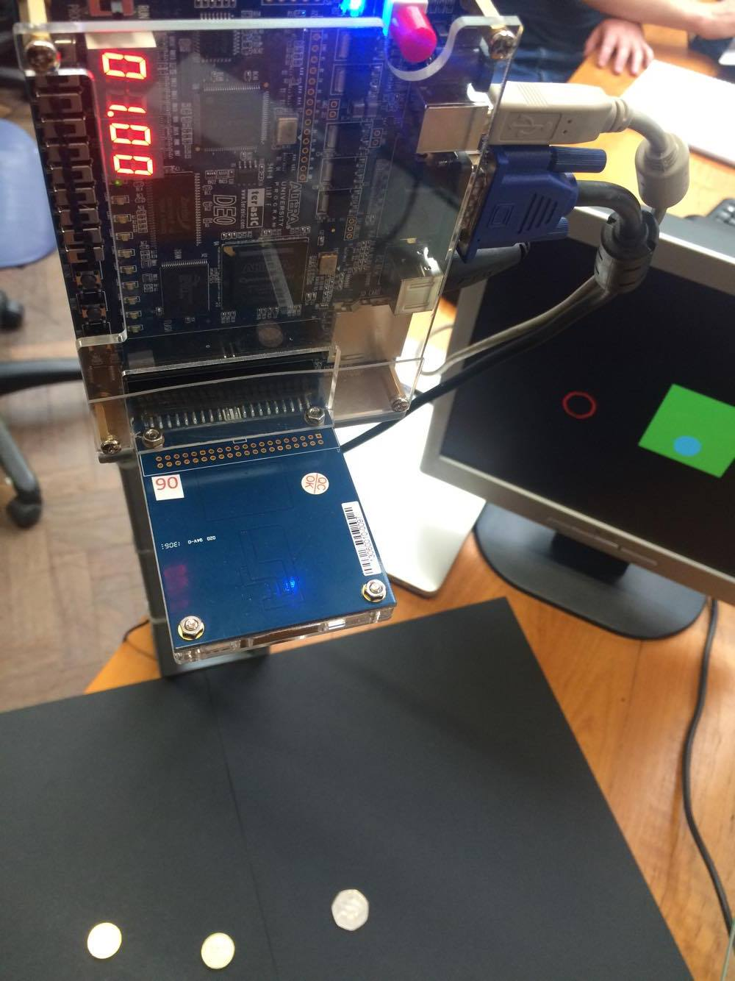
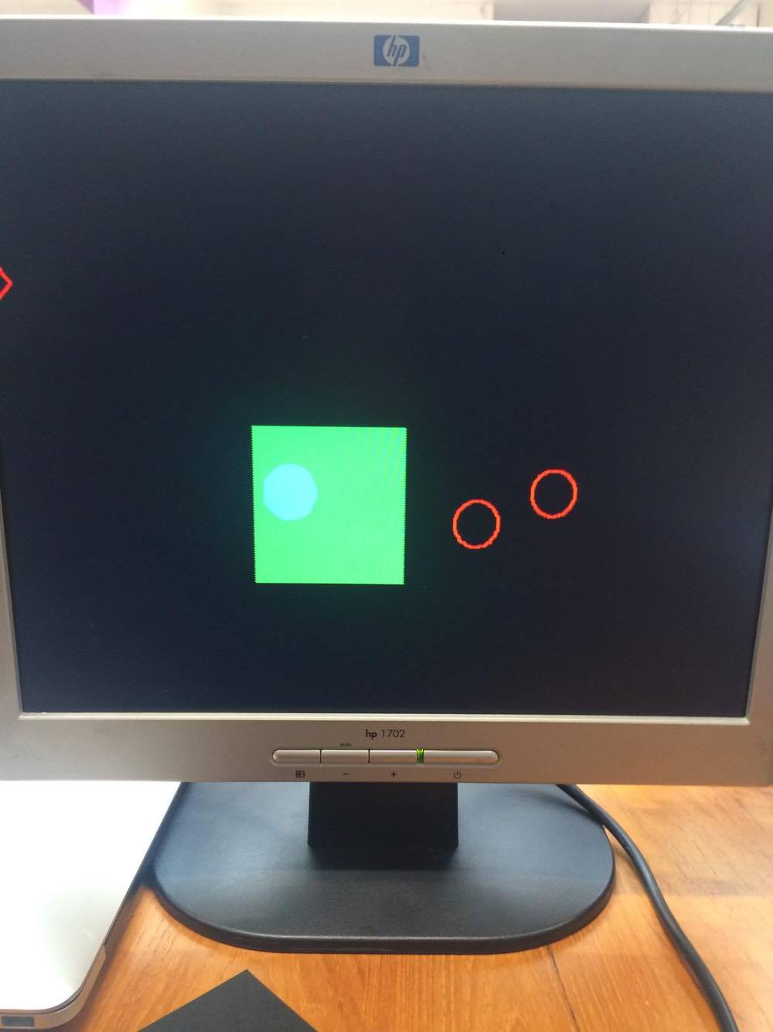
Introduction coin detector, basic functionality

Slide 3
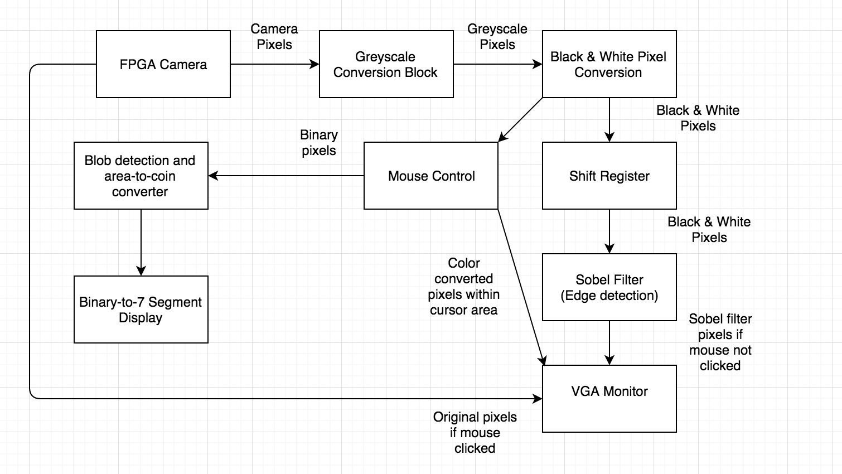
High-level description of system flow chart

Slide 4
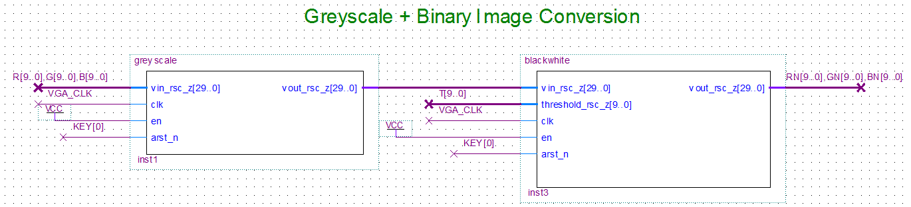
High-level description of system image-manipulation, binary image

Slide 5
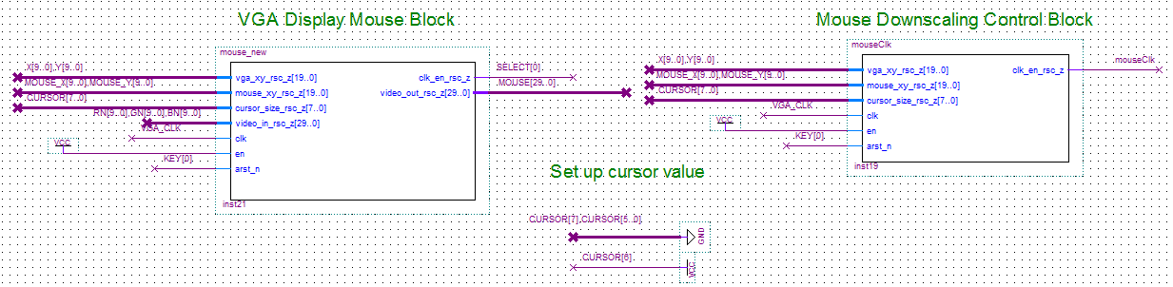
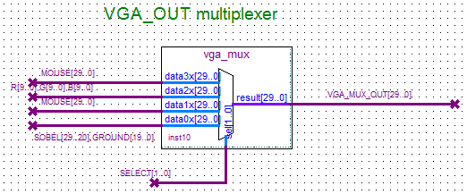
High-level description of system mouse control, downscaling block

Slide 6
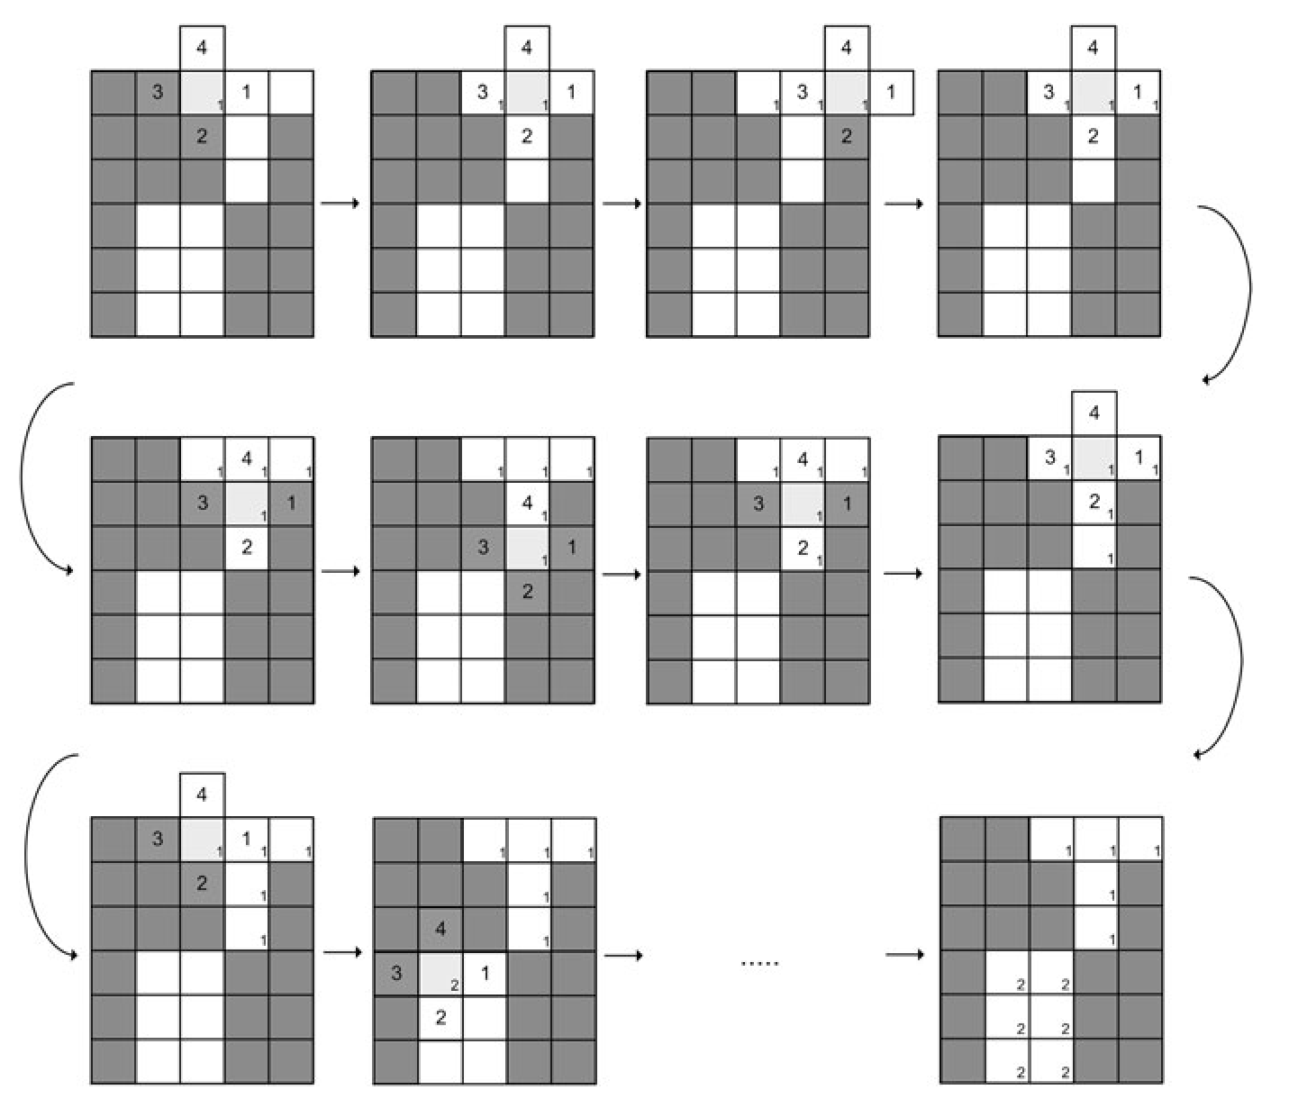
High-level description of system blob-detection algorithm

Slide 7
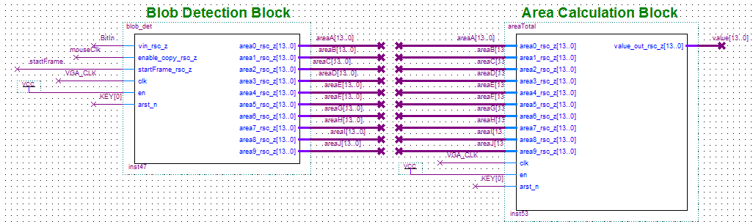
High-level description of system blob-detection block, area calculation block

Slide 8
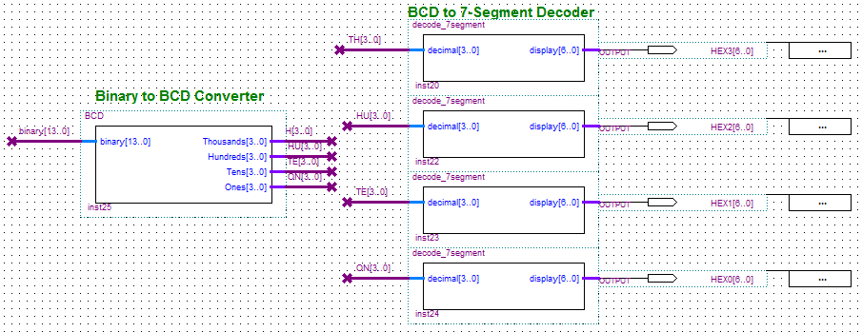
High-level description of system area calculation block, binary to BCD block, BCD to 7 segment block

Slide 9
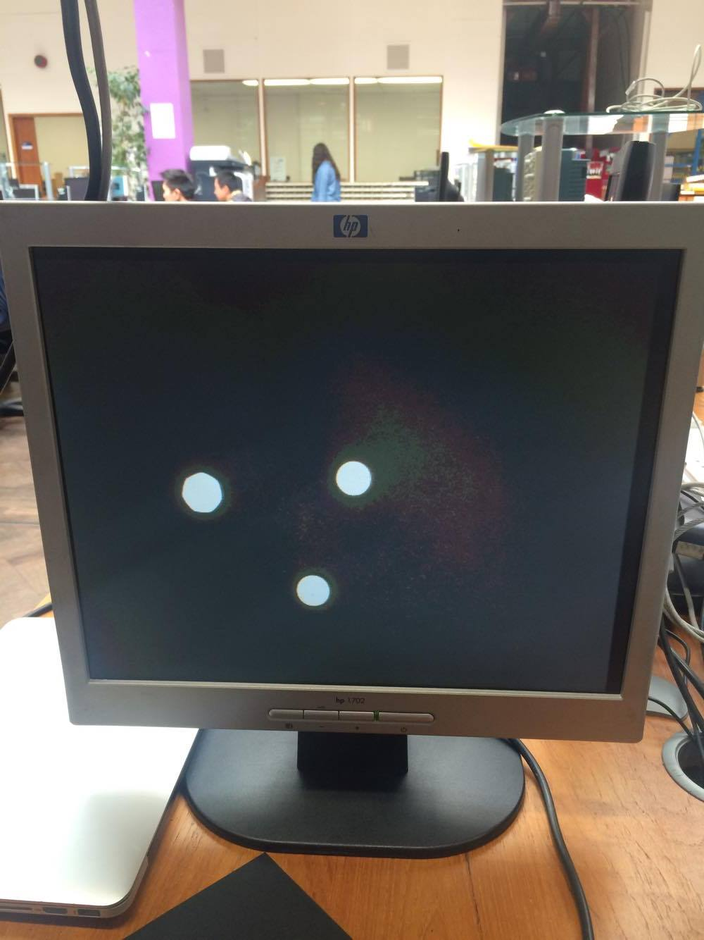
High-level description of system user interface/interaction

Slide 10
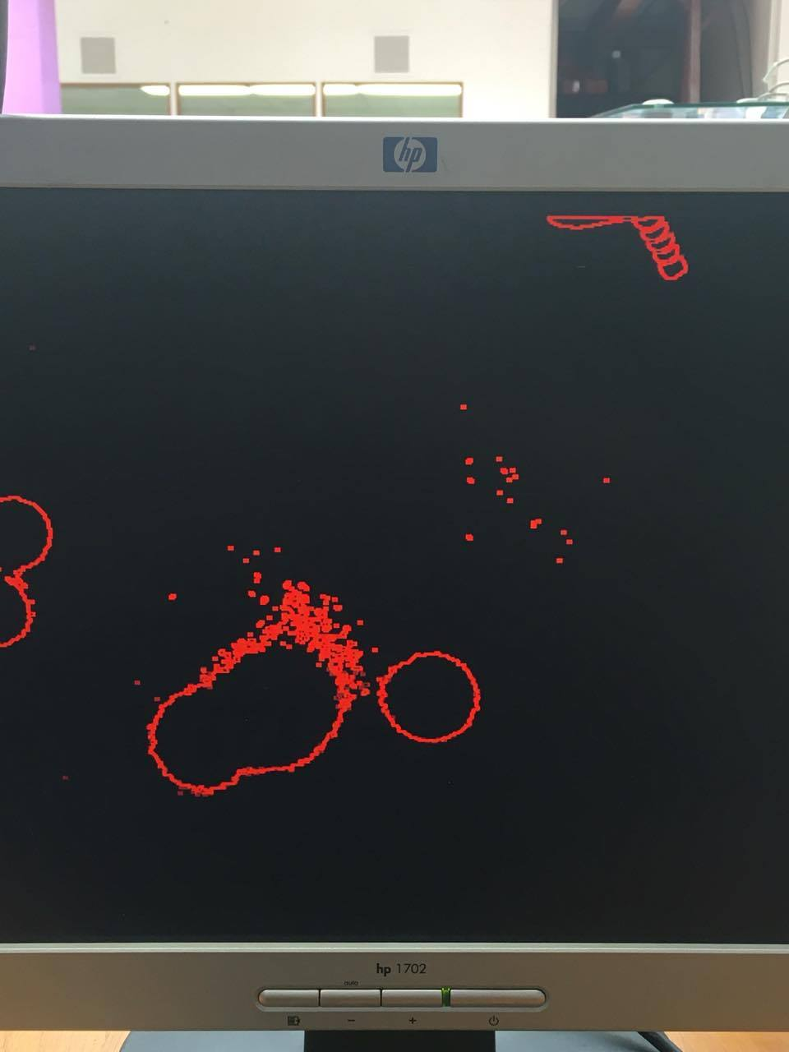
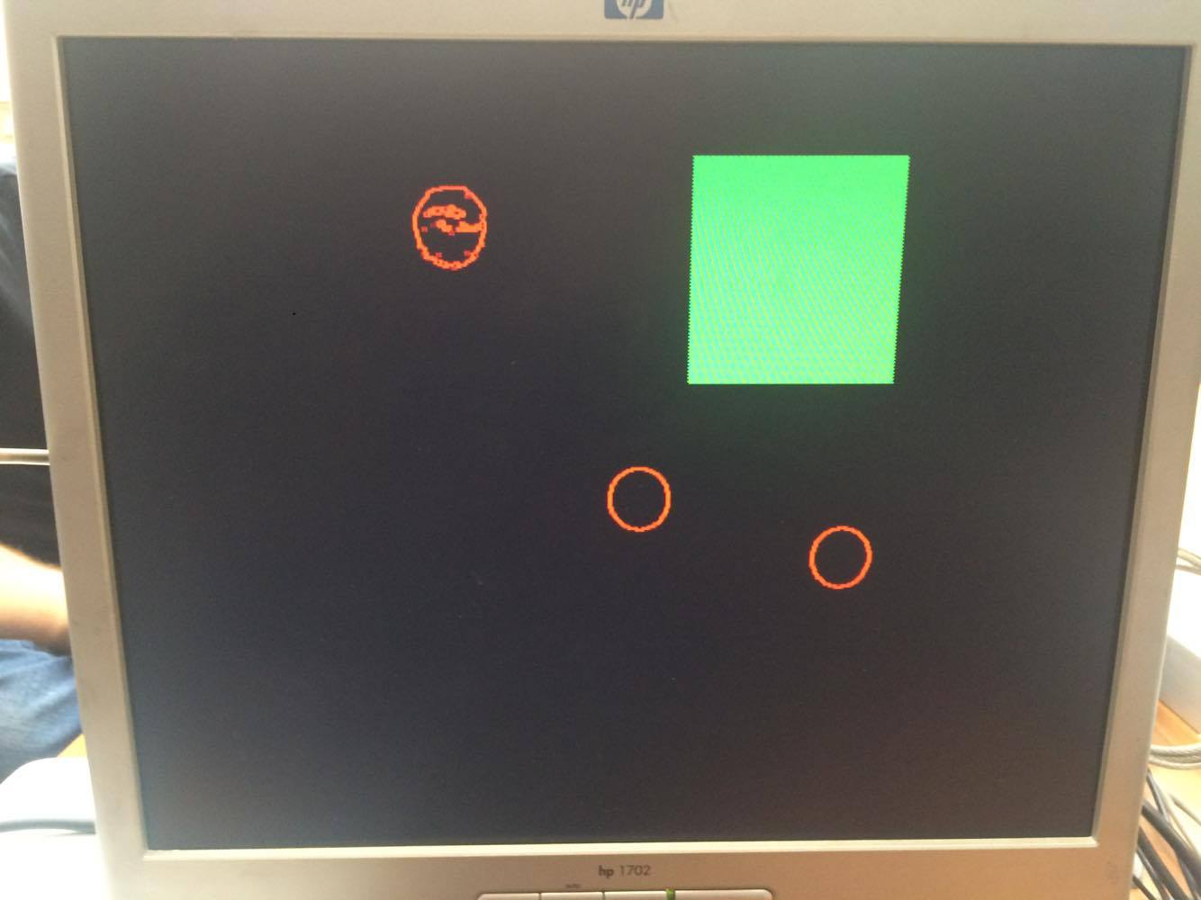
Limitations and assumptions light issues

Slide 11
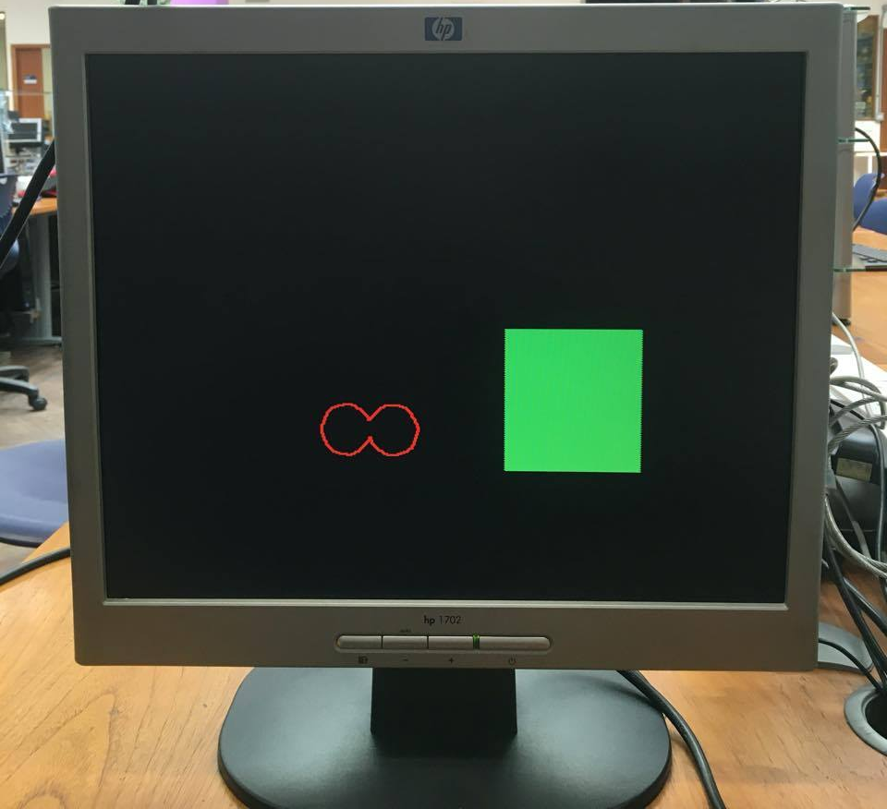
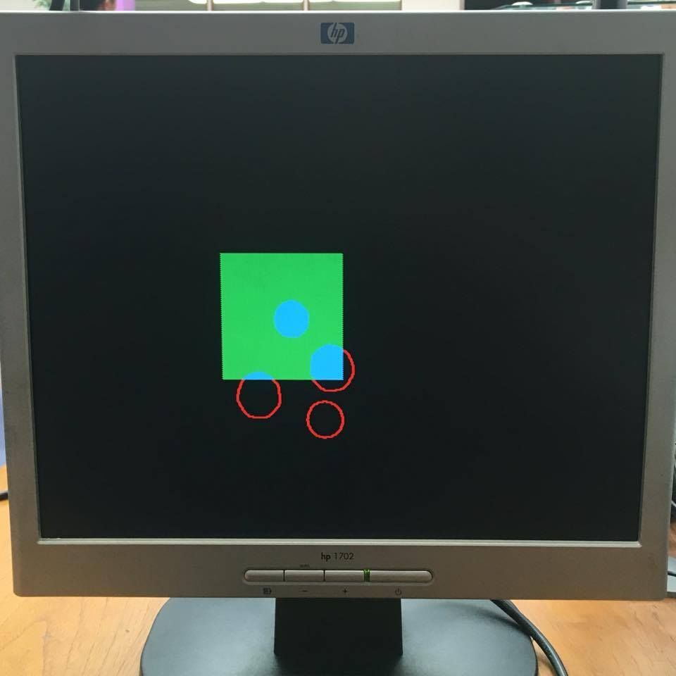
Limitations and assumptions number of coins, overlapping, incomplete areas, memory limitations

Slide 12
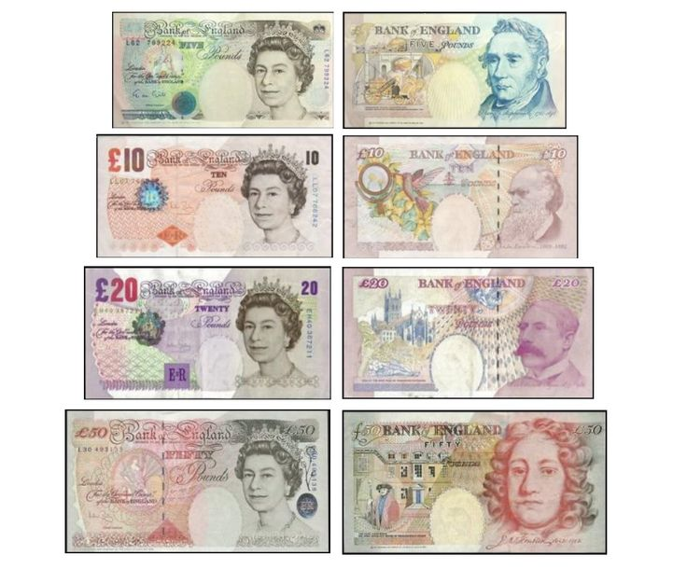
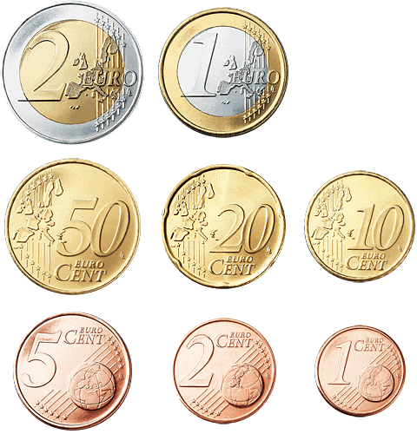
Improvements notes, other currencies, more coins, larger inspection area

